Slide 1

Cloud Adoption Framework for Azure ​Overview
November 2020
Notes:
Welcome slide

Slide 2

Daniel Segan
Sr. Cloud Solution Architect
NE Region, Media & Entertainment
daniel.segan@microsoft.com
https://github.com/danielsegan
@dsegan

Slide 3
What is the Cloud Adoption Framework
Proven Guidance to help you create and implement the business and technology strategy to succeed in the cloud
Tools
Asses, Measure, plan, communicate, validate, test, operate
Documentation
Processes, approaches, guidance, technical, training
Best Practices
Technical, security, operational

Slide 4
What is the Cloud Adoption Framework
Aligns business and technology objectives
Prepares people with technical readiness
Adjusts processes to drive business and technical change
Enables business outcomes through implementation of the defined technical plans

Slide 5
Achieve balance. Deliver modernization. Deli
Best practices
Templates
People
Process
Technology
Documentation
Tools
Control & Stability
Speed &
Results
Align—business, people and technology strategy.
Achieve—business goals with actionable, efficient, and comprehensive guidance.
Deliver—fast results with control and stability.
Notes:
When you think about cloud adoption….
It’s not just swapping out technology, but changing your enterprise, the culture behind it, and you too.
The CAF offers best practices from our employees, partners, and customers who have already undertaken the cloud journey.
The Cloud Adoption Framework brings together people, process, and technology—a strategy that’s aligned to your business goals.
Quickly—efficiently, and with actionable guidance, it provides guidance for your organization’s agile business transformation.
Leading people through change is difficult. It’s not just the technology that changes. It’s your people and processes too.
We can help guide you through.
<Transition>: How does the Cloud Adoption Framework work for your business?

Slide 6
Plan
An iterative process that supports your business …
as it evolves
Govern
Manage
Define strategy
Adopt
Ready
Notes:
Not a one time deal. Not meant to be static.

Slide 7
Cloud Maturity Stages
Increase maturity
Reduce time to market
Enable business innovation
Policy driven risk management (control-based)
Full Governance lifecycle
Value
Scale-up additional workloads
Develop and re-use certified services
Proof the value
Launch first workloads
Enable playgrounds
Mitigation and remediation through policies and scripts
Experiment with Azure
Audit policies at Management Group and Subscription levels
Mimics on-premises controls using scripts with manual verification
Governance
Mimics on-premises networking and workloads (VM Centric)
Hub-and-spoke(Heavy shared services)
Cloud Native Foundation
Cloud Native
Architecture
Manual Steps required for deployment
Services Certified by IT
Pipelines and automation introduced for infra
Pre-Approved Architectures
Policy, Subscriptions, resources etc... using pipelines
BUs free to use anything policies allows
BUs teams are full-stack owning apps and infra
Operations
Customer invests in Azure
Executive Sponsorship
Cloud Team but no Cloud Office
Cloud Office formed
Partnership with key Depts
Depts teams training and transitioning to agile and full stack
Self Service IT
Cloud Center of Excellence
Organization
Early Cloud
Fully Enabled
Notes:
The Cloud Journey…
Expressed as a maturity model.

Slide 8
What it is... (and isn’t)
It is …
A way to align your business and technology strategy
An opinionated way to approach cloud adoption
A foundational starting point
A way to find out where you are at … and meet you there
It is not ...
Only for organizations starting their journey
The only way to approach cloud adoption
a static and immutable process
something you do once
purely technically focused

Slide 9
Microsoft Cloud Adoption Framework Proven guidance to accelerate your cloud adoption journey
Define strategy
Define business justification and expected outcomes
Plan
Align actionable cloud adoption plan to business outcomes
Ready
Prepare people, process and environment for change
Adopt
Migrate or Innovate
Implement desired changes across IT and business processes
Govern
Comply, control and secure
Manage
Operate and optimize
https://aka.ms/adopt/overview
Notes:
The Cloud Adoption Framework contains detailed information to cover an end-to-end cloud adoption journey:
It begins with setting the business strategy, which should align to actionable technology projects that deliver on the desired business outcomes.
It then describes how the organization must:
Prepare its people with technical readiness.
Adjust processes to drive business and technology changes.
Enable business outcomes through implementation of the defined technology plan.
Finally, it covers cloud operations, such as governance, resources, and people and change management.

Slide 10
Tools, templates, and assessments
Define strategy
Plan
Ready
Adopt
Cloud journey tracker
Business outcome template
Azure DevOps demo generator
Cloud adoption plan template
Azure setup guide
Readiness checklist
Naming and tagging tracking template
Landing zone blueprints
Strategic migration assessment and readiness tool (SMART)
Azure migration guide
Azure innovation guide
Govern
Manage
Governance benchmark
Governance process template
Cost Management process template
Deployment acceleration process template
Identity process template
Resource consistency process template
Security baseline process template
Microsoft Azure Well-Architected Review
Best practices source code
Operations management workbook
aka.ms/adopt/tools-templates
Notes:
<Key point> We have tools, assessments, and other assets to support your cloud adoption journey.
<Transition> Although the tools, templates, and assessments enable you to manage your own journey, not everyone wants to do this alone. Let's talk about the role of Microsoft Partners - and how they can lighten the load.

Slide 11
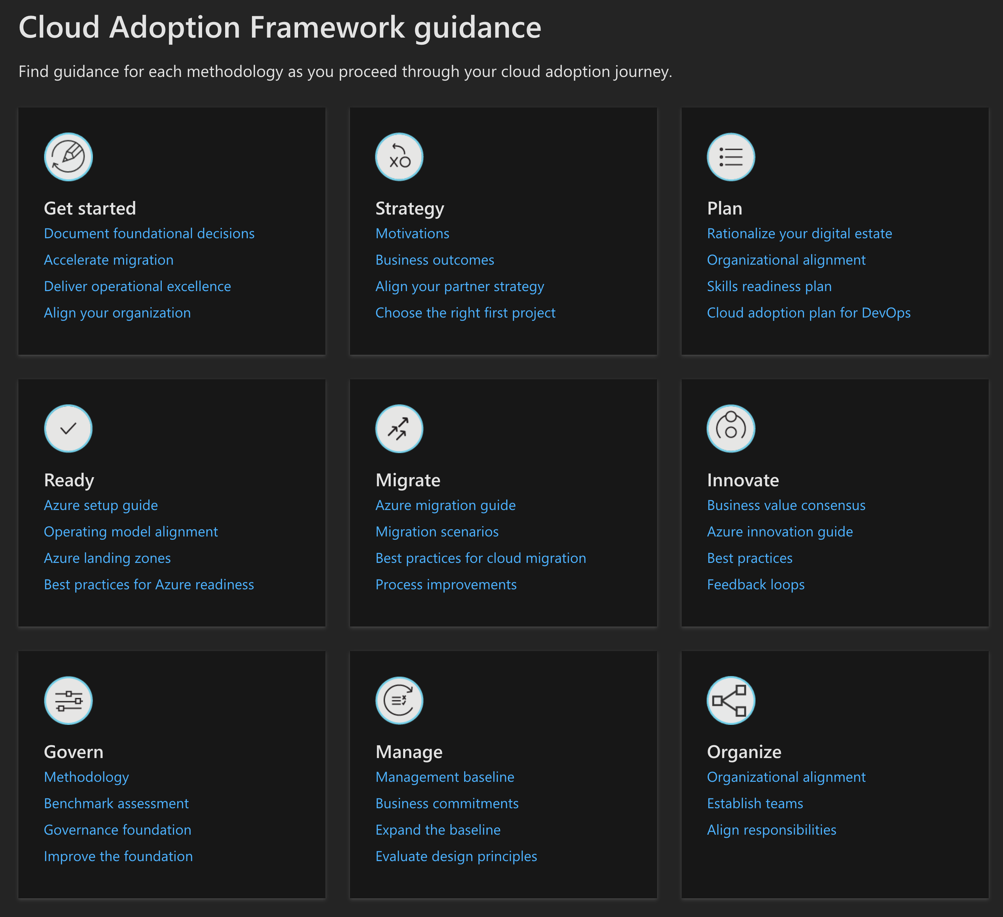
CAF Documentation and Best Practices
https://aka.ms/CAF

Slide 12
Microsoft Cloud Adoption Framework for Azure
Adopt
Define strategy
Understand motivations
Business outcomes
Business justification
Prioritize project
Plan
Digital estate
Initial organization alignment
Skills readiness plan
Cloud adoption plan
Ready
Azure Setup guide
First landing zone
Expand the blueprint
Best practice Validation
Migrate
• First workload migration
• Expanded scenarios
• Best practice validation
• Process improvements
Innovate
• Innovation guide
• Expanded scenarios
• Best practice validation
• Process improvements
Govern
Methodology • Benchmark
initial best practice • Governance maturity
Manage
Business commitments
operations baseline • Ops maturity

Slide 13
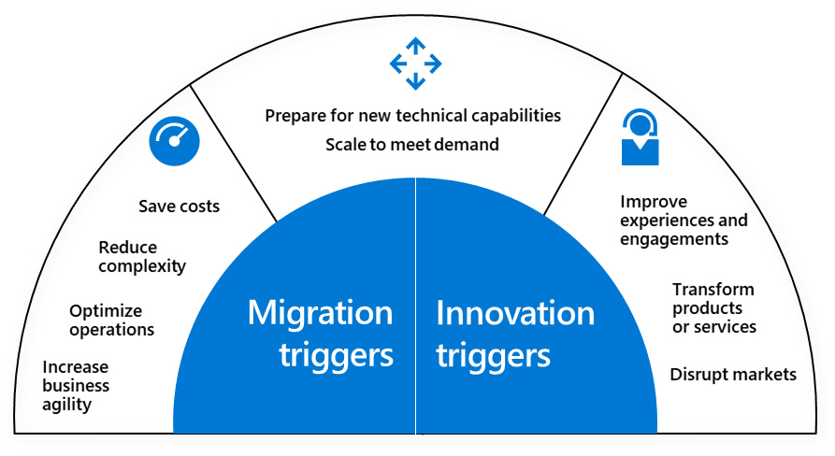
Define Strategy
Motivation + Outcome + Justification
Notes:
Why are you moving to the cloud?
Boss says I have to
The developers are clamoring for it
The customers need a better solution
Some common migration and innovation triggers include:
Preparation for new technical capabilities
Gaining scale to meet market or geographic demands
Cost savings
Reduction in vendor or technical complexity
Optimization of internal operations
Increased business agility
Improvements to customer experiences or engagements
Transformation of products or services
Disruption of the market from new products or services – i.e. bringing an innovative within to global reach

Slide 14
Cloud Adoption Motivations
Why is the company adopting the cloud?
More than one motivation is common in most cloud adoption efforts
Critical Business Events
Data center exit
Mergers, acquisition or divestiture
Reductions in capital expenses
End of support for mission critical technologies
Regulatory compliance, data sovereignty requirements
Reduce disruptions and improve IT stability
Migrate Motivations
Cost Savings
Reduction in vendor or technical complexity
Optimization of internal operations
Increase business agility
Prepare for new technical capabilities
Scale to meet market demands
Scale to meet geographic demands
Innovation Motivations
Prepare for new technical capabilities
Build new technical capabilities
Scale to meet market demands
Scale to meet geographic demands
Improve customer experiences / engagements
Transform products or services
Disrupt the market with new products or services

Slide 15
Business Outcomes
Fiscal
Agility
Reach
Customer engagement
Performance
Sustainability
Measurable (usually a key for justification)
Clear and Transparent
Cross-Functional

Slide 16
Business Justification
Identify justification
Build a ROI model to validate
Azure total cost of ownership (TCO) calculator
Azure pricing calculator
Digital Estate Rationalization
Understand accounting impact
Profit centers, chargeback, show back

Slide 17
Partner Strategy
Azure Solution Partners
CSP, Managed Services or Systems Integrator Partner
FastTrack for Azure
Microsoft + Partners
Azure Migration Program
technical skill building, step-by-step guidance, free migration tools, and potential offers to reduce migration costs

Slide 18
Project Plan and Roadmap
First Projects
Expect to learn a lot
Will lead to process refinement
Should align with motivations
Demonstratable progress toward business outcome
Use the Cloud Journey Tracker
Build, and Refine your Roadmap
Accumulate success
Understand and learn from failures
Build on knowledge
Gain momentum and accelerate

Slide 19
Plan
Rationalize Digital Estate
Determine best approach
5 R’s -- (Rehost, Refactor, Rearchitect, Rebuild, Replace with something else))
Initial organizational alignment
Governance and Adoption alignment
Skills readiness plan
Get everyone up to speed on everything
Cloud adoption plan
Build an actionable plan

Slide 20
Plan | Rationalize Digital Estate
Cloud rationalization is the process of evaluating assets to determine the best approach to hosting them in the cloud (public or hybrid)
Rationalization can take place using an Incremental approach or ‘Power of 10’ where the cloud strategy team selects the first 10 applications to be migrated which are a mix of simple and complex workloads; (recommended approach)
The output of a rationalization effort is a prioritized backlog of all assets that are affected by the chosen transformation.
Use costing models from your chosen cloud provider to forecast costs for your prioritized backlog; for Azure, we have pricing tools like Azure Migrate, Azure pricing calculator and Azure cost management. Ensure that hybrid is incorporated into the costing models

Slide 21


Plan | Initial Org Alignment
Implementing Cloud adoption plan requires some initial alignment of different stakeholders who will make the plan a reality
Cloud Adoption Team
Cloud Governance Team
Speed vs Control
Create a balance between speed or moving quickly and control or reducing risks by have teams accountable for adoption and governance.
While cloud adoption team is required to execute cloud adoption tasks, governance team ensures processes and controls are implemented

Slide 22
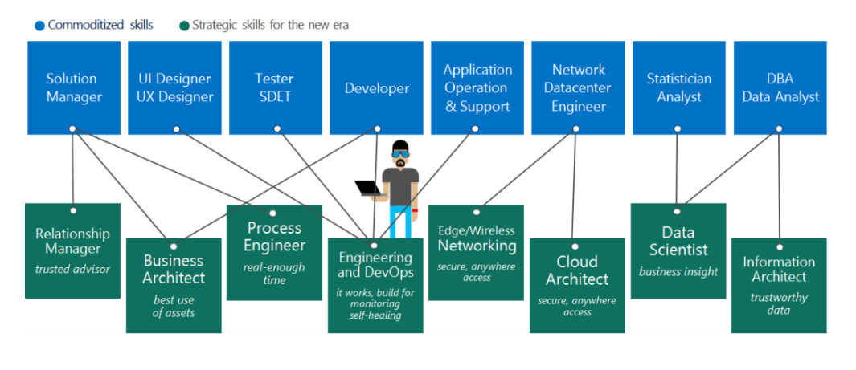
Plan | Skills Readiness Plan
Cloud computing is a technology shift and a new set of skills are required to support cloud solutions
Identify the gaps
Look across teams
Create an org-wide learning plan
1
2
3

Slide 23
Plan | Cloud Adoption Plan
Translate strategy and effort into an actionable cloud adoption plan
Prerequisites: Confirm that all prerequisite steps have been completed before you create your plan.
Define and prioritize workloads: Prioritize your first 10 workloads to establish an initial adoption backlog.
Align assets: Identify which assets (proposed or existing) are required to support the prioritized workloads.
Review rationalization: Review rationalization decisions to refine adoption-path decisions: Migrate or Innovate.
Define iterations and releases: Iterations are the time blocks allocated to do work. Releases are the definition of the work to be done before triggering a change to production processes.
Estimate timelines: Establish rough timelines for release planning purposes, based on initial estimates.

Slide 24
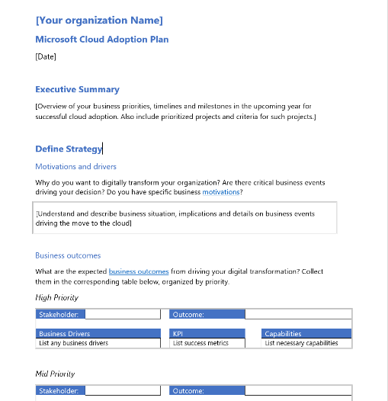
Plan | Cloud Adoption Plan Template
Cloud adoption plan converts the aspirational goals of the cloud adoption strategy into an actionable plan
All the cloud teams leverage the cloud adoption plan to guide technical efforts, in alignment with the business outcomes.
Download the template and get started with creating your plan

Slide 25
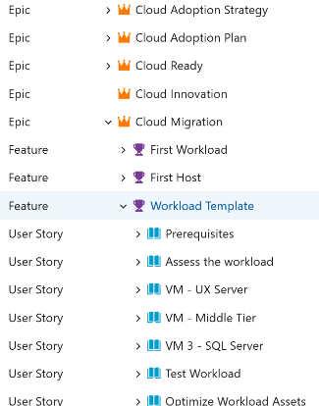
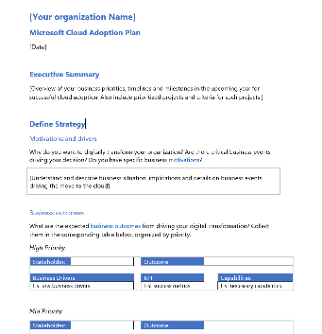
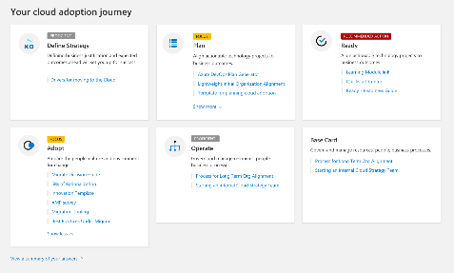
Strategy, Plan & Ready Tooling
Cloud Adoption Plan
Azure DevOps Generator
https://azuredevopsdemogenerator.azurewebsites.net/

Slide 26
Ready
Azure Setup Guide
Operating Model
Azure Landing Zones

Slide 27
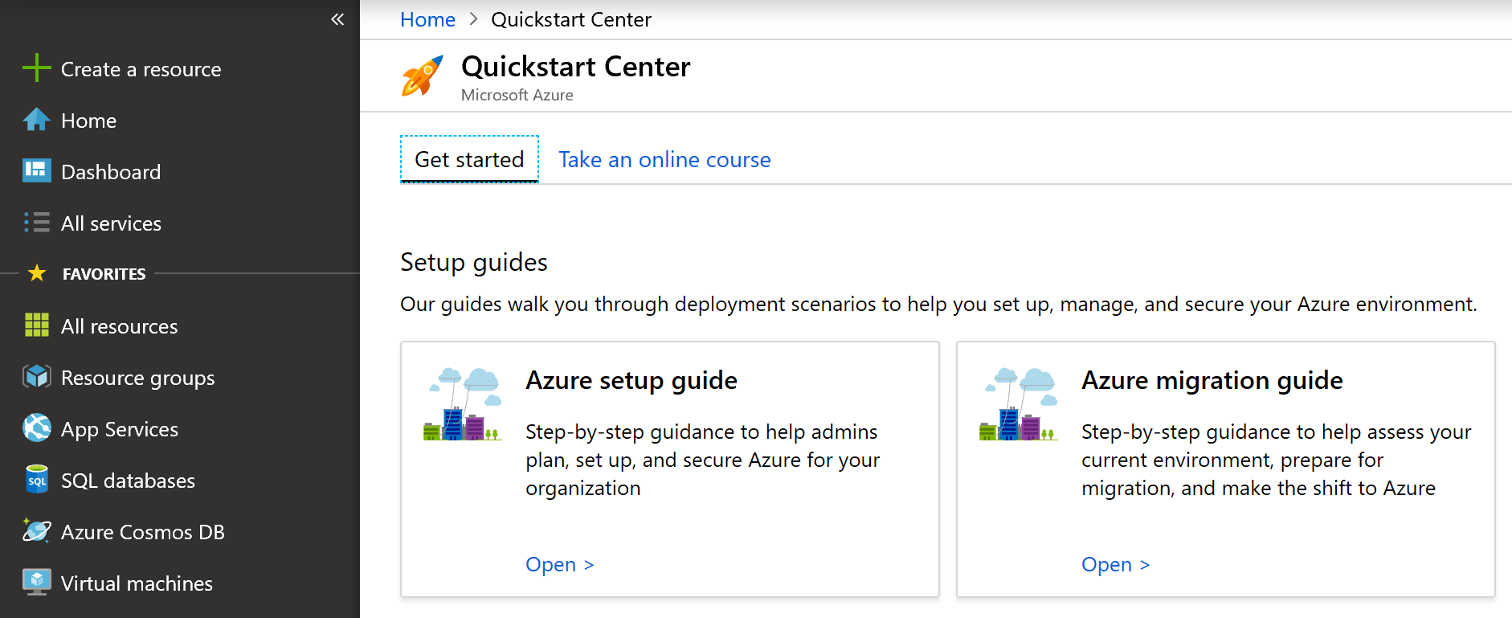
Ready | Azure Setup Guide
Prepare the cloud environment before building and deploying solutions using Azure services
The Azure Setup Guide provides guidance on how to organize resources, control costs, and secure and manage your organization helping you create your landing zone in Azure
The guide is also published in the Azure Quickstart Center
Aka.ms/aqc within the Azure Portal

Slide 28

Metropolis
Using an analogy, this is similar to how city utilities such as water, gas, and electricity are accessible before new houses are constructed. In this context, the network, IAM, policies, management, and monitoring are shared 'utility' services that must be readily available to help streamline the application migration process.

Slide 29
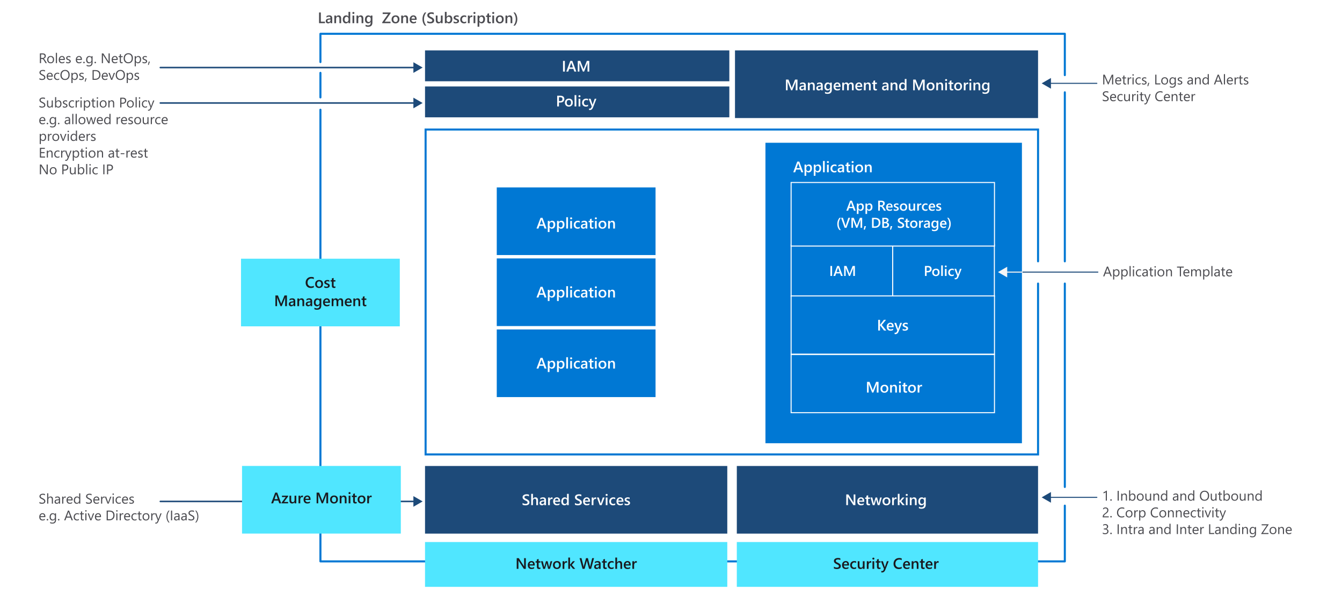

Slide 30
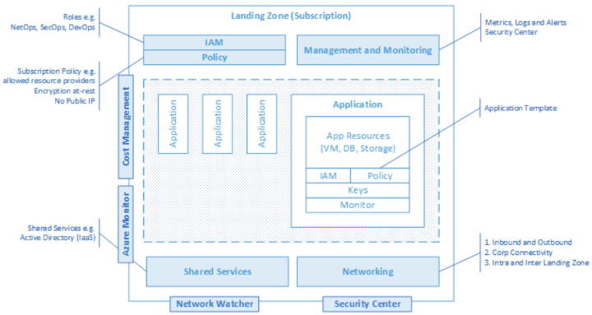
Landing Zones The principle purpose of the “Landing Zone” is therefore to ensure that when an application lands on Azure, the required “plumbing” is already in place, providing greater agility and compliance with enterprise security and governance requirements.
Notes:
Building a landing zone (LZ) is a fundamental requirement for any Azure consumption. No LZ = No ACR.
However, we have also learned the hard way that a poorly designed LZ eventually will slow down Azure growth or even stop it.
The challenge is that our LZ guidance so far has been very generic, based on high level design guidelines and reference architectures, that required customers (and partners) to take a lot of hard technical decisions – and not all choose wisely.
We are doing a better with the latest versions of Cloud Adoption Framework (CAF), but we were far behind AWS here.

Slide 31
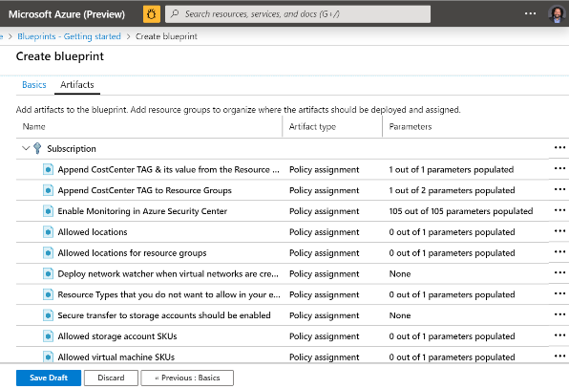
CAF Foundation Blueprint
http://aka.ms/cafbpfoundation

Slide 32
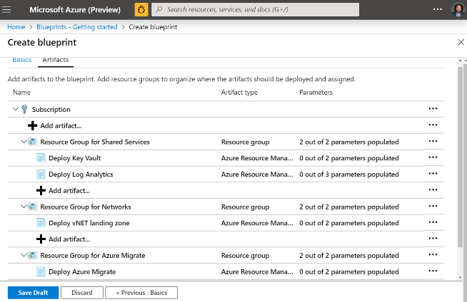
CAF Migrate landing zone Blueprint
http://aka.ms/cafbplandingzone

Slide 33
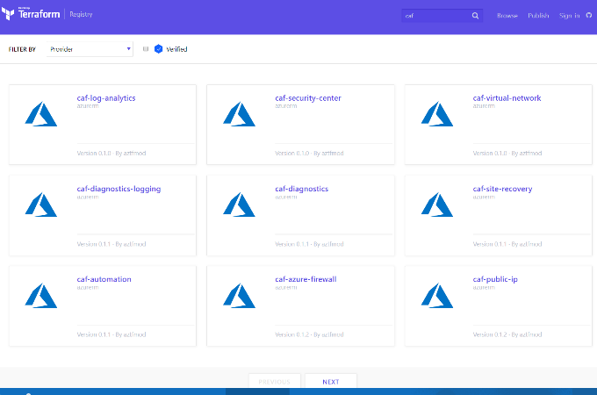
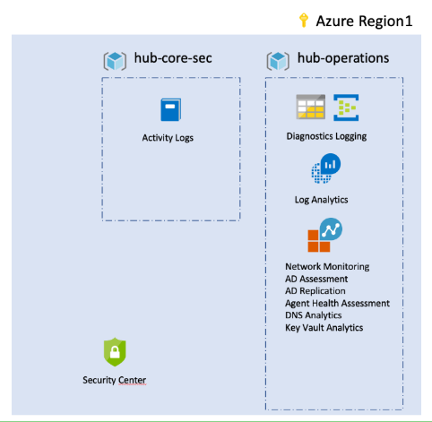
Azure Native or Open Source tooling
Notes:
ARM & Terraform

Slide 34
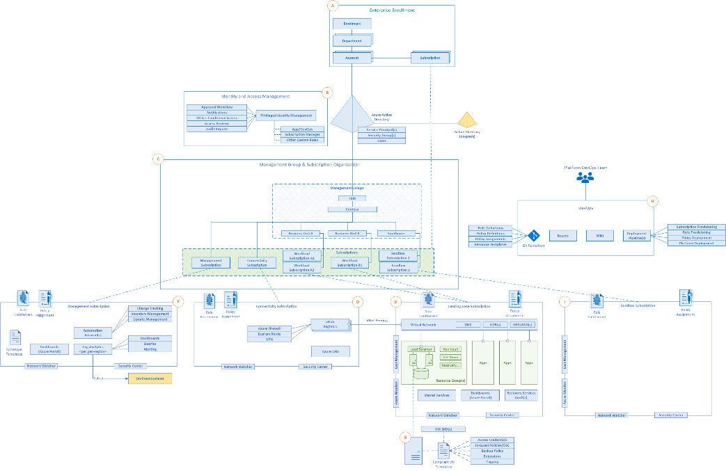
CAF North Star
http://aka.ms/adopt/northstar

Slide 35
Adopt
Migrate - Azure Migration Guide
Transactional systems
Line of Business applications
Analytics
VDI/WVD applications
Innovate – Azure Innovation Guide
Build-measure-learn loop products
Data democratization
Mobile/Social engagement
Global Reach
Predict and influence

Slide 36
Govern
Methodology
Benchmark
Initial governance foundation
(Iterative) improvement of governance foundation

Slide 37
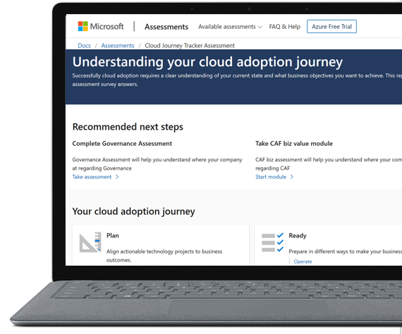
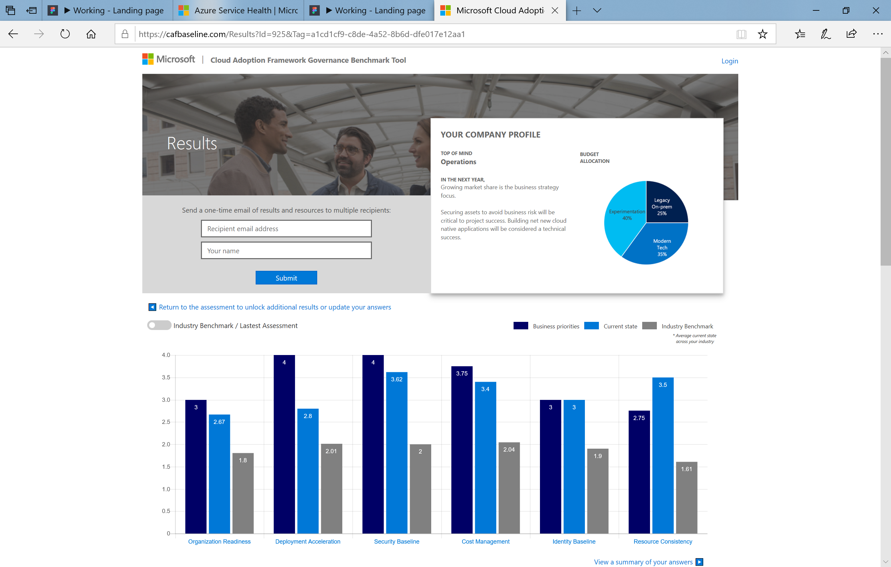
Assessment
Governance Benchmark
Understand your current state and prepare for your cloud journey
aka.ms/adopt/gov/assess

Slide 38
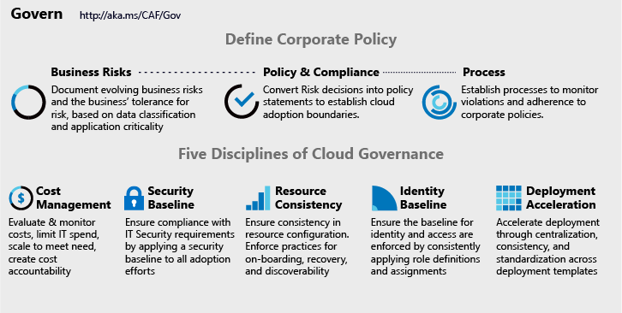
Cloud Adoption Framework | Governance Model
Governance End State that fosters trust and builds confidence
Corporate Policy
Governance is a big, intimidating topic. Establish proper scope by mitigating tangible risks through corporate policy.
Cloud Governance Disciplines
Governance is a team sport. Empower multiple team members by decomposing corporate policy changes into five actionable disciplines.
Cloud Governance Team
A team of governance minded cloud architects can evolve these disciplines, ensure governance consistency, and accelerate deployment.

Slide 39
Making Governance Actionable with Native Tools
Azure Monitor
Azure Blueprints
Azure Policy
Azure Cost Management
Azure Advisor
Azure Portal
Azure EA Content Pack
Azure Blueprint
Azure Policy
Resource Grouping & Tagging
Resource Manager Templates
Azure Advisor
Azure DevOps
Azure Site Recovery
Azure Backup
Azure Automation
Azure Blueprints
Azure Policy
Azure Security Center
Azure Sentinel
Subscription Design
Encryption
Hybrid Identity
Azure Networking
Azure Automation
Azure Blueprints
Azure Policy
Azure Monitor
Azure Advisor
Resource Manager Templates
Resource Graph
Management Groups
Azure Blueprints
RBAC
Azure AD
Azure AD B2B
Azure AD B2C
Directory Federation
Directory Replication

Slide 40
Integrating 3rd Party Tools
Monitoring 3rd parties
OpsCompass
Splunk
AppDynamics
Solarwinds
New Relic
Data Dog
Cost Management 3rd parties
HashiCorp Terraform (ROI tools)
Cloudcheckr
Deployment 3rd parties
Nagios
HashiCorp Terraform
devops tools like Chef, Puppet, Ansible, Zabix
Security baseline 3rd parties
Splunk
HashiCorp Vault
F5
Gemalto
Palo Alto
CheckPoint
Dome9
Discovery, onboarding, and recovery 3rd parties
ServiceNow
HashiCorp Terraform
3rd party identity providers
HashiCorp Vault
RSA
Omada
Ping Identity
SailPoint
Notes:
What third parties can be used to accomplish similar goals?

Slide 41
Manage
Establish a management baseline
Define the criticality classifications, cloud management tools ,and processes
Inventory and visibility – agents, centralized logging, incident awareness
Operational compliance – resource / env. constancy
Protect and Recover – short- and long-term recovery
Define business commitments
Document supported workloads to establish commitments
(Iteratively) Expand the management baseline
Make use of best practices

Slide 42
Methodology to enable cloud management
Cloud operations disciplines
Business alignment
1
Criticality
Establish management baseline
Management
baseline
Inventory and visibility
Operational compliance
Protect and recover
Impact
Enhanced baseline
Platform specialization
Workload specialization
Advanced
operations
Commitment
Expand management baseline
Advanced operations and design principals
Define business commitments
3
4
2
Notes:
The preceding steps create actionable approaches to deliver on the Microsoft Cloud Adoption Framework's Manage methodology. The Microsoft Cloud Adoption Framework guides customers in establishing tooling to enable cloud management across management baselines, business commitments, enhanced management baseline, and advanced operations.

Slide 43




Cloud journey with Microsoft Cloud Adoption Framework for Azure
Know your customer
Envision
Validate
Commit
Onboard
Realize value
Preparation
STRATEGY
PLAN
READY
ADOPT
GOVERN
MANAGE
Strategy workshop
Digital
estate rationalization
Skills readiness plan
SMART assessment*
Governance baseline discussion*
Review best practices
and scope
Identification & Targeting
Ready workshop
Governance baseline review
Deploy workloads
Review architecture
Stakeholder mapping
Initial org alignment (CCOE)
Prioritized projects
Partner engaged on Landing Zones
Account assessment
Motivations & Triggers
Migration workshop*
Governance workshop
Plan workshop
Cloud adoption plan
Deploy Governance MVP
Architecture design
Optimize & identify new opportunities
Strategy
Plan
Ready
Adopt
Govern
Manage
Cloud Journey Tracker
Pitch deck (Overview or checklist specific)
Workshop deck
Cloud adoption plan or DevOps generator
ESI / Skills plan
Workshop deck
Landing Zones blueprint
SMART assessment
Workshop deck
Support plans
Best practices
Workshop deck
AQC guidance
AMP/FTA/Dev & Test offer
Governance benchmark
Workshop deck
AQC guidance
Architecture Review
Overview deck
AQC guidance
Service incident playbook
Templates, Tools & Resources
Motivations and expected business outcomes, at the account level
Establish Cloud Center of Excellence
Adoption plan, with prioritized projects and skilling
Partner engage
Deploy Landing Zone
Skills plan execution
Deploy workloads on Azure
Support plans in place
Deploy Governance MVP
Establish governance team
Architecture design (RA) session
Establish SLAs/ops for management baseline
Optimize, manage, secure workloads
Advisor recos’
Outcomes
Partners & Services engagement
KEY
Key resource
Template
Tool
Iteration/Review
Milestones
Action
* If applicable

